Slide 1
Outage Prediction
Predicting outage risk to assist resident preparation
Joanna Huang, Kalvin Kao, Justin Plumley
November 7, 2017

Slide 2
Background:
“In terms of the total number of lost hours of electricity, Puerto Rico and the US Virgin Islands are in the midst of the largest blackout in US history...”
Power outages due to downed power lines are a frequent occurrence in the US
Business Problem: Extreme weather events result in economic, social, and physical disruptions and inconvenience and loss of critical lifeline systems for residents living in disaster areas
Project objective:
Use weather and power datasets to predict outages and their potential magnitude to inform residents and assist in preparation
Notes:
http://www.cnn.com/2017/10/26/us/puerto-rico-power-outage/index.html

Slide 3
Datasets for Learning
Learn whether an outage will occur given weather
Learn the magnitude (number of affected customers) of a power outage if an outage occurred, given weather
NOAA
EIA Electric Power
(National Oceanic and Atmospheric Administration)
Provides weather history over a long period of time and / or locations
Data fields: sky conditions, visibility, temperature, humidity, wind speed, press
Data size: up to 30 observations/day (per city)
https://www.ncdc.noaa.gov/
Major Disturbances and Unusual Occurrences, Year-to-Date 2017
Data fields: Year, Month, Event Date and Time, Restoration Date and Time, Duration, Utility/Power Pool, NERC Region, Area Affected, Type of Disturbance, Loss (megawatts), Number of Customers Affected
Data size: 50-100 observations a year
https://www.eia.gov/electricity/monthly/epm_table_grapher.php?t=epmt_b_1

Slide 4
Datasets for Prediction
Weather and power forecasts
Predict future outages and their magnitudes given weather and power consumption forecasts
Forecasts are updated regularly, and become more accurate for closer dates
Predictions may be updated as forecasts are updated
Weather Underground API
Real-time forecasts
Data fields: location, observation time, weather description, temperature, humidity, wind (dir, mph, pressure), precipitation)
Data size: Depends on number of cities
http://www.wunderground.com/weather/api/

Slide 5
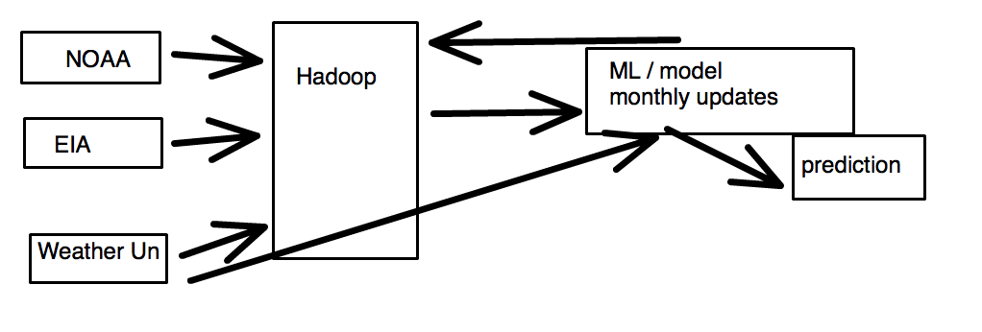
Design
Steel Thread
Data: Weather and power outage data from single state (e.g. Maine)
1 day of weather
Store: Hive/Hadoop
Model: Predict ‘no outage’
Output: csv
Complexity overview:
Volume
Estimate maximum of ~100mb data per weather station
Variety
Excel, CSV
i.e. temperatures, sky conditions
Velocity
Update learning monthly
Update predictions daily

Slide 6
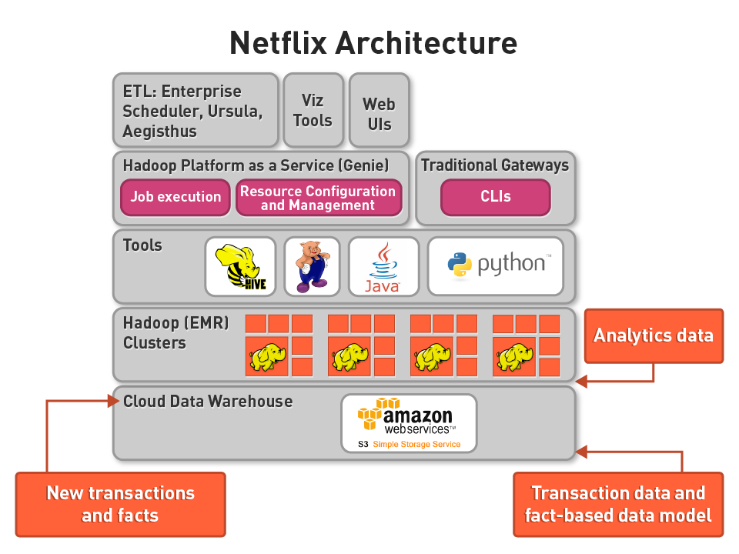
Architecture
Architecture: Netflix
One data warehouse for restoring predictive analyses
Storage: Hadoop
Small, structured, semi-complete data
Low latency, low quality, and basic query requirements
Already scaled out
Processing: Apache Spark-SQL
MLlib, RDDs, pySpark

Slide 7
Questions/Concerns
3 Vs?
A lot of previous work in this area
More accurate predictions with soil moisture, tree density

Slide 8
Next Steps
High-speed winds during a thunderstorm may cause trees around an electric grid to crash into the distribution system feeders causing an outage in that area. This model predicts potential vulnerability to ensure the trees in the most critical areas with the highest risk to be trimmed first.
“Power outages in the distribution system are primarily caused by wind blowing trees and limbs onto power lines,” says Guikema. “Therefore, our model includes a number of different measures of wind, the type of trees, and the soil moisture conditions, which provides a measure of the stability of the soil and the likelihood of a tree being uprooted.”
A group of researchers led by Seth Guikema at the University of Michigan has created a model that predicts the number of power outages “based on wind speed estimates, population density, soil moisture levels, drought indices, and information about trees in each census tract.”

Slide 9
Design/Architecture
Steel Thread
Complexity
Architecture/Scale-Out
We will be building out steel thread starting with weather and power outage data from
Pipeline Overview:
Data ingestion → processing/transformations → analysis → serving layer
Volume
Velocity
Variety
Notes:
No Scale Out ▪ Storage layer – PostgreSQL, etc. ▪ Processing layer – SQL, Python, etc. ▪ Machine Learning – Python with Scikit-learn, R, etc. ▪ Streaming media – Python single threaded API, etc. ▪ Data Visualization – freebee as Tableau has a scale out server!
o Full scale out ▪ Storage layer – Hive, Redshift, etc. ▪ Processing layer – Spark, Hadoop MapReduce, etc. ▪ Machine Learning – Spark MLlib, Mahout, etc. ▪ Streaming Media – Storm, Heron, Spark Streaming, Kafka, etc. ▪ Data Visualization – freebee as Tableau has a scale out server!

Slide 10
Background
Power outages due to downed power lines are a frequent occurrence in the US
Other developed nations, such as Germany and the UK, have replaced some overhead power lines with underground power lines
Aesthetic purposes
Less hazardous
Protected from weather or vandalism
Why not the US?
High initial costs
Some geographical/geological limitations
Business Problem:
Undergrounding may also decrease operational costs over the lifetime of the cables… but by how much?
Notes:
https://en.wikipedia.org/wiki/Undergrounding
Undergrounding can increase the initial costs of electric power transmission and distribution but may decrease operational costs over the lifetime of the cables.
http://www.electrocuted.com/2016/08/25/bury-power-lines-underground-to-prevent-electrocution-deaths/

Slide 11
Overview
Historical weather and power outage data
Learn whether an outage will occur given previous weather
Learn the magnitude (number of affected customers) of a power outage if an outage occurred, given preceding weather
Weather and power forecasts
Predict future outages and their magnitudes given weather and power consumption forecasts
Forecasts are updated regularly, and become more accurate for closer dates
Predictions may be updated as forecasts are updated
Business Use Case:
Determine which regions of the US will gain long-term savings by undergrounding power lines

